Slide 1
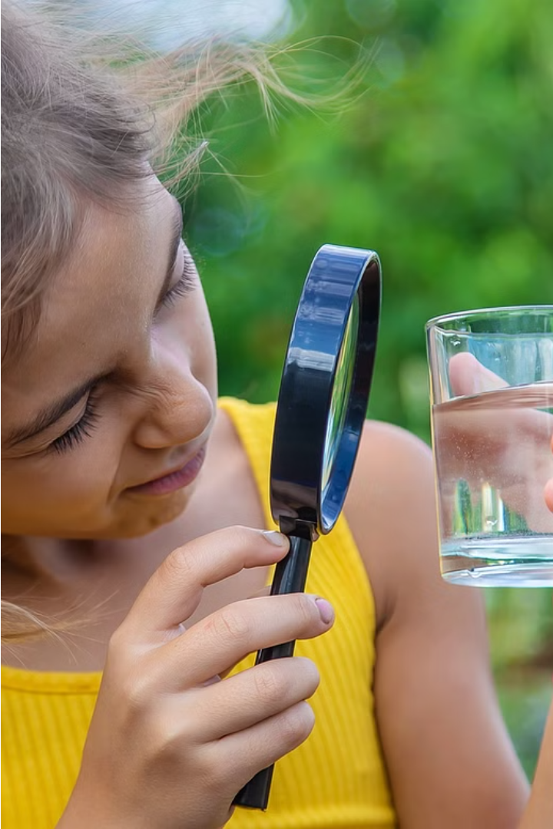
ARDUINO-BASED WATER QUALITY SURVEILLANCE
Team numbers :
SURENDHAR S - 210701271
TARUNVISHAAL L - 210701285
SRI SAI B - 210701258
.

Slide 2
AGENDA :
I. ABSTRACT
II. INTRODUCTION
III.OBJECTIVE
IV. LITERATURE SURVEY
a. KEY CHALLENGES
b. MOTIVATION
V. EXISTING SYSTEM
VI. PROPOSED SYSTEM
VII. MODULES
VIII. SYSTEM ARCHITECTURE
IX. CONCLUSION AND FUTURE ENHANCEMENTS
X. REFERENCES
.

Slide 3

ABSTRACT
Water quality surveillance is critical for safeguarding human health and maintaining ecological balance in freshwater ecosystems. In this project, we propose an Arduino-based system designed for efficient and real-time monitoring of water quality parameters. The system employs a Turbidity sensor integrated with Arduino to detect the quality. The modular architecture of the system ensures flexibility and scalability, enabling customization to meet specific monitoring requirements in diverse environmental settings

Slide 4
INTRODUCTION
Water quality monitoring is a critical challenge in today's world, as access to clean and safe water is essential for public health and environmental sustainability. This project aims to address this challenge by leveraging the power of IoT technology to provide real-time insights into the state of local water resources. Ensuring the safety and purity of water resources is of paramount importance for sustaining human health, supporting ecosystems, and promoting socio-economic development worldwide.

Slide 5
OBJECTIVE
To monitor the water quality parameters such as pH, turbidity, dissolved oxygen, and temperature in real-time.
To promote environmental sustainability by leveraging IoT technologies to improve water resource management and protect ecosystems through proactive monitoring and management of water quality.
To Gather and store comprehensive datasets of water quality metrics over time.
To develop a user-friendly system so that it can be easily deployed and accessed by a wide range of people, from public officials to environmental organizations.

Slide 6
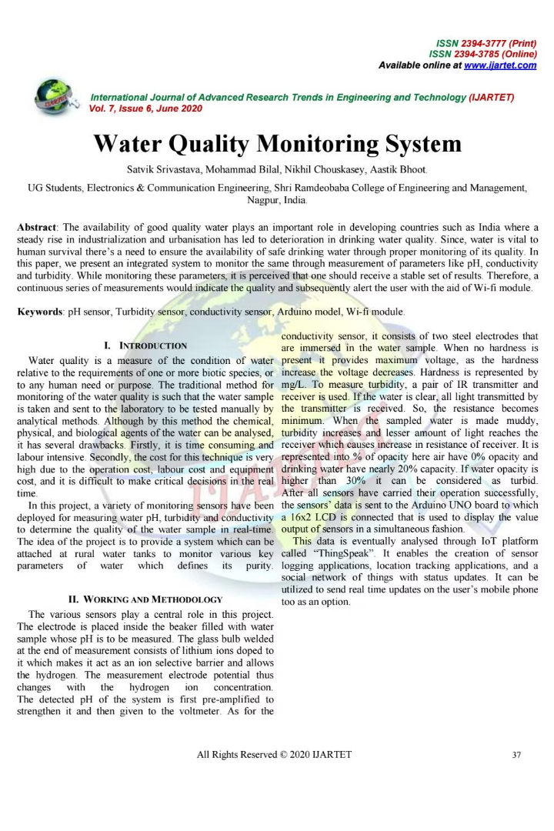
LITERATURE SURVEY
[1] The “A Comprehensive Survey on IoT-Based Water Quality Monitoring Systems“
published in 2016 covers sensor technologies, communication protocols, data analytics
methods, and real-world applications.
[2] The “Integration of IoT and Machine Learning for Water Quality Monitoring: A Review”
paper was published in 2017. It explores machine learning algorithms for data analysis,
and predictive modeling in water quality monitoring projects.
[3] The “Sustainability Aspects of IoT-Based Water Quality Monitoring: A Literature Review“
paper was published in 2017 discusses energy efficiency, resource utilization, and
environmental impact considerations.

Slide 7
LITERATURE SURVEY
[4] The “Real time water monitoring system using Internet of Things“published in 2018
discusses an IoT-based water quality monitoring system employing Arduino Uno and
various water quality sensors. The focus is on the system's ability to measure pH levels,
turbidity, and temperature
[5]. The “Design and Implementation of a Water Quality Monitoring System Using Arduino ”
paper was published in 2019. This study focuses on the design and implementation of a
water quality monitoring system using Arduino technology. The system uses multiple
sensors to measure water quality parameters and sends the data to a cloud server for
analysis.

Slide 8
KEY CHALLENGES
Sensor Reliability
Data Integration
Ensuring the continuous and accurate operation of water quality sensors in harsh environmental conditions is a key challenge.
Seamlessly integrating sensor data with cloud-based analytics platforms requires overcoming connectivity and interoperability obstacles.
Scalability
User Adoption
Designing a system that can be easily scaled to monitor water quality across large geographic areas is crucial.
Encouraging widespread adoption and use of the water quality monitoring system among diverse stakeholders is a significant challenge.

Slide 9
MOTIVATION
The motivation for the "Arduino-Based Water Quality Surveillance" project lies in the need for a cost-effective, real-time solution to monitor and ensure the quality of water in various environments, thereby protecting public health, safeguarding ecosystems, complying with regulatory standards, and supporting agricultural and industrial needs. By leveraging affordable technology, this project aims to provide continuous data collection and analysis, enabling timely interventions and fostering community awareness and engagement in water conservation efforts, while also serving as an educational tool to promote innovation and learning in environmental science and technology.

Slide 10
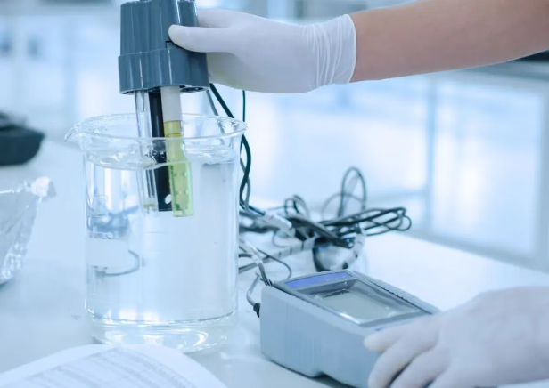
EXISTING SYSTEM
Traditional water quality monitoring systems have relied on manual sampling and laboratory analysis, which can be time-consuming, costly, and provide limited real-time insights. These legacy approaches often struggle to keep pace with the dynamic nature of modern water resources, hindering timely detection and response to water quality issues.

Slide 11
PROPOSED SOLUTION
Our proposed system for water quality detection utilizes a turbidity sensor interfaced with a microcontroller to measure water clarity. The sensor data is processed and analyzed by the microcontroller, which then logs the information and communicates it wirelessly to a central server or user interface for real-time monitoring. A calibration mechanism ensures measurement accuracy, while a protective enclosure safeguards the system's components from environmental factors. This system enables continuous monitoring of water quality parameters, facilitating informed decision-making and timely interventions for environmental management and public health protection.

Slide 12
MODULES
Arduino
Bread Board
Turbidity sensor
I2C sensor module
LCD Display
Jumper wires
RGB LED

Slide 13
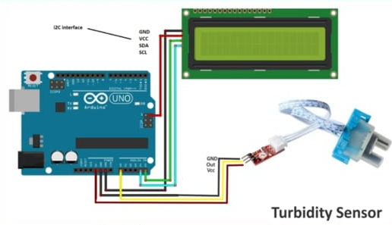
SYSTEM ARICHTECTURE

Slide 14
CONCLUSION
The project "Water Quality Detection Using Arduino" represents a significant advancement in the realm of environmental monitoring. Through the integration of Arduino technology and specialized sensors, the system offers a practical and accessible solution for assessing water quality parameters. By providing real-time data on factors such as pH levels, turbidity, and conductivity, it empowers users to make informed decisions regarding water safety and management. This has the potential to greatly benefit both communities and ecosystems by enabling early detection of contamination and facilitating proactive measures for conservation.

Slide 15
FUTURE ENHANCEMENT
A potential future enhancement for the project "Water Quality Detection Using Arduino" could involve the integration of wireless communication capabilities. By incorporating technologies such as Wi-Fi or Bluetooth, the system could transmit real-time data to a central monitoring station or a mobile application. This would allow users to remotely access and analyze water quality information, enhancing convenience and accessibility. Additionally, implementing data logging functionality could enable historical tracking of water quality trends, facilitating long-term analysis and decision-making.

Slide 16
REFERENCES
[1] Lohani, P., & Neopane, A. (2021). Design and Implementation of Water Quality Monitoring System Using Arduino. International Journal of Scientific Research in Computer Science, Engineering and Information Technology,
[2] Mittal, P., Arora, R., & Sharma, N. (2020). IoT Based Water Quality Monitoring System Using Arduino and ESP8266. In Proceedings of the International Conference on Inventive Computing and Informatics (ICICI) (pp. 1-6). IEEE.
[3] Rajput, A., & Soni, N. (2018). Arduino Based Real-Time Water Quality Monitoring System. In Proceedings of the International Conference on Nascent Technologies in Engineering (ICNTE) (pp. 1-5). IEEE.

Slide 17
REFERENCES
[4] Medhi, J. P. S., & Dutta, A. (2020). Development of Arduino-Based Water Quality Monitoring System. International Journal of Scientific & Engineering Research (IJSER), 11(3), 456-460.
[5] Singh, R. K., & Gupta, N. (2021). Design and Implementation of a Water Quality Monitoring System Using Arduino. Journal of Environmental Monitoring and Assessment, 193(4), 202-209.

